Slide 1
Ethics & Compliance in Business
2021-2022 Ethics Roundtable Series
Tracy Gonzalez-Padron
Director, DFEI Collegiate Program at UCCS

Slide 2
What is Ethics & Compliance
Why is it important
Key Elements
Teaching E&C
Notes:
What is Ethics & Compliance

Slide 3
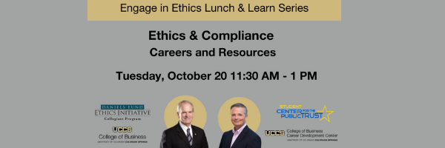


UCCS / DFEI Resources

Slide 4



Ethics
Compliance
Value system
Guide decisions and actions
Doing what is right regardless of what the law says
Ethics Policies Promote the Rationalization for Values and Integrity
Rules & Regulations
Meet legal requirements
A reactive word that forces people to make a conscious choice
Compliance Policies Discourage Opportunities for Rule-Breaking
Notes:
define

Slide 5
Create Program Structure
1
Ethics Officer
Board Oversight
Establish Corporate Standards
2
Code of Conduct
Create Investigation Procedures
4
Reporting Mechanism
Investigation Process
Reporting Relationship
Global Considerations
Whistleblower Protection
Educate the Workforce
3
Develop Training Plan
Execute Training
Assess Learning
Ethical Guidance
Assess Program Effectiveness
5
Measuring ethical performance
Audit Committee
Internal Auditing
Implementation
Notes:
define

Slide 6
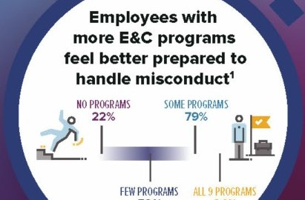


Slide 7
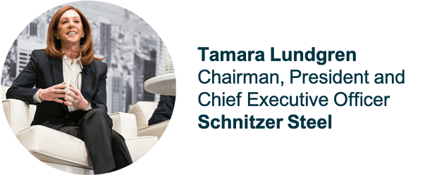
"Employees are picking employers that are aligned with them on impact, or personal values. People didn’t used to talk about values. That said, today, values and purpose resonate very differently than compliance, or conduct."

Slide 8
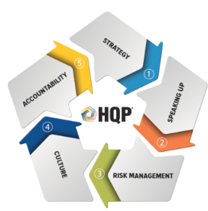


Slide 9
Psychological safety
Notes:
Culture!!!

Slide 10
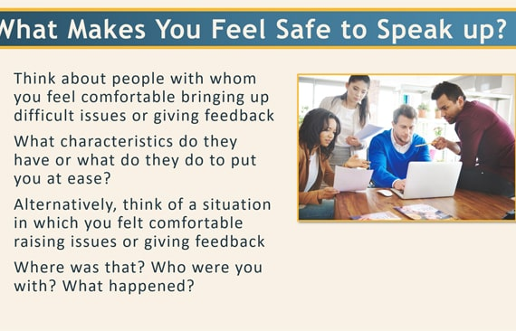
Notes:
Start by asking participants to form groups of 3 or 4 people.
Then give them a sheet of A1 paper per group and some marker pens.
Next, ask the groups to brainstorm and come up with a list of things that makes them feel safe to speak up.

Slide 11
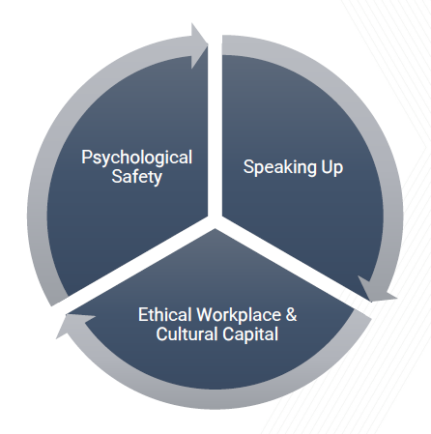

Slide 12

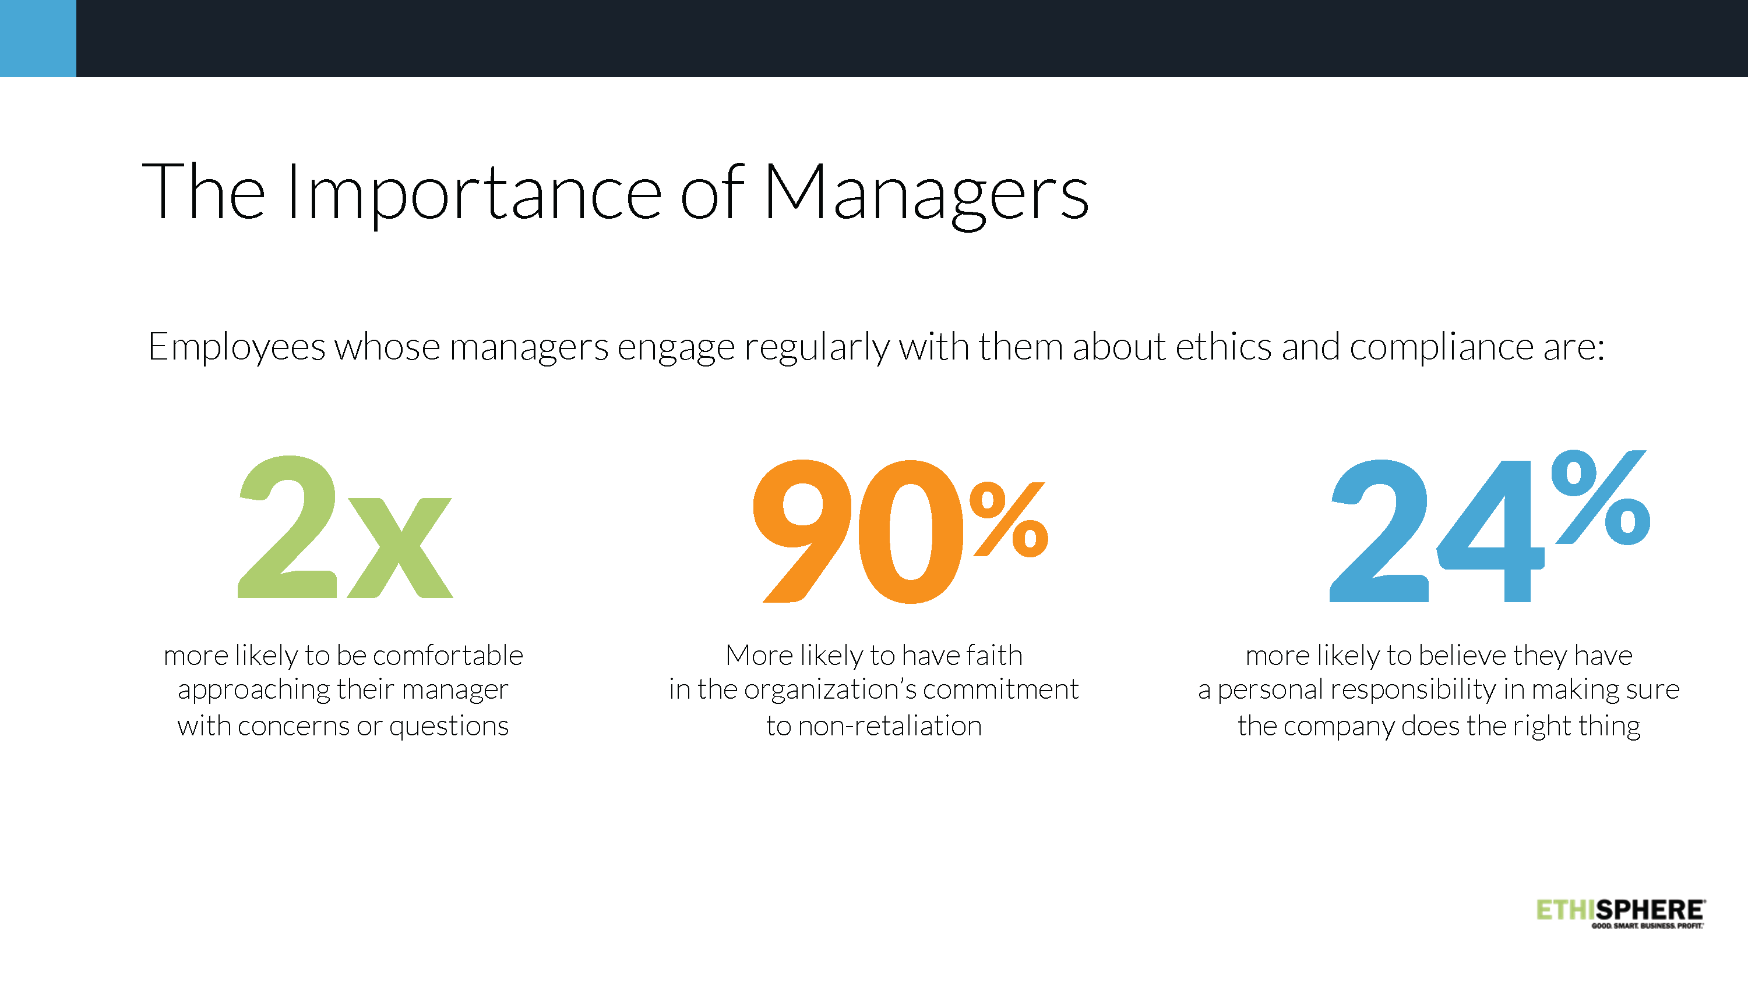

Slide 13
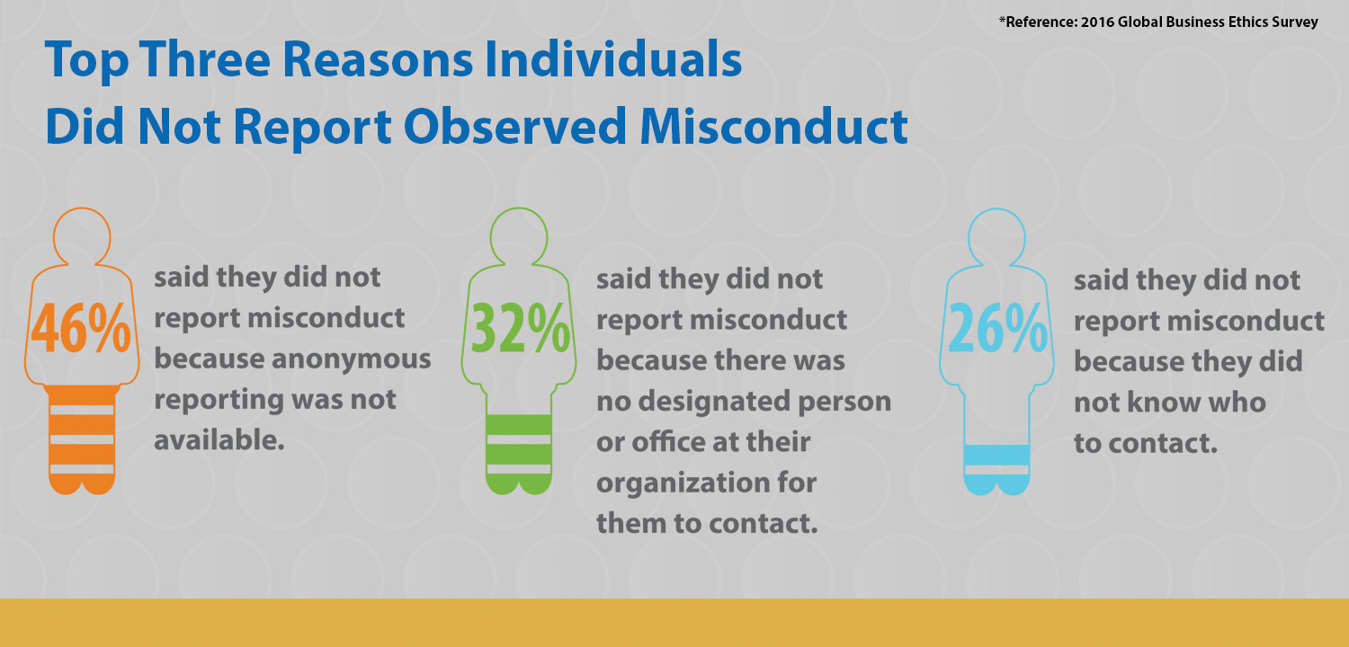

Slide 14
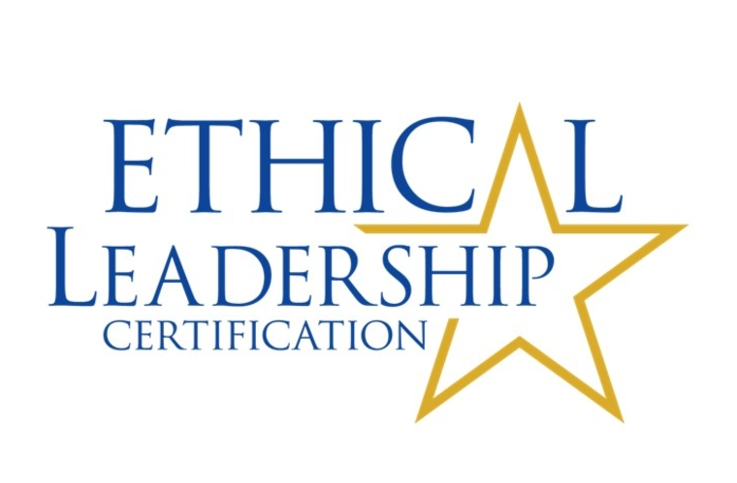

Slide 15
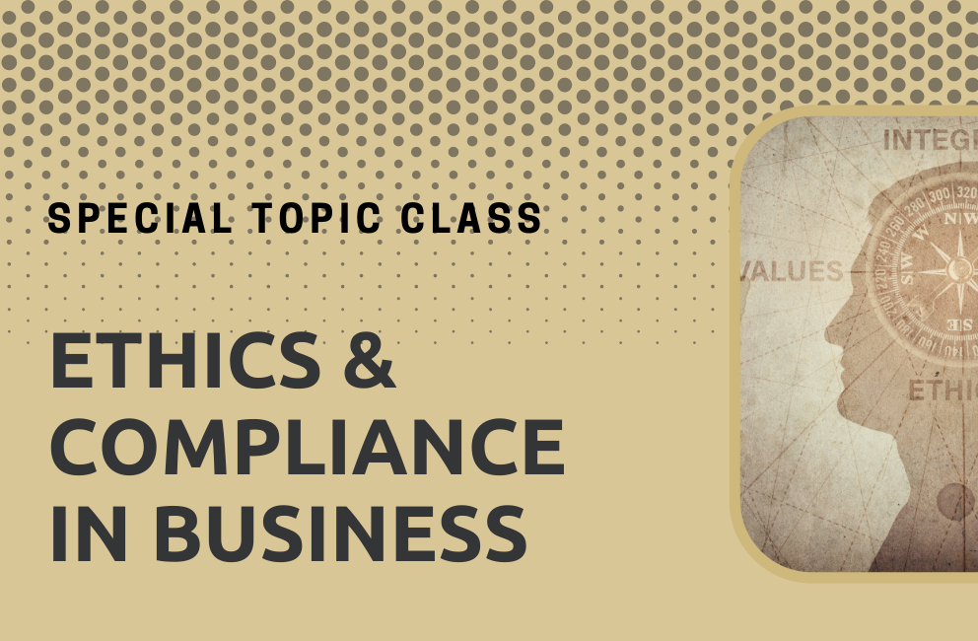

Slide 16


Course Description
The course focuses on preparing individuals to be ethical leaders in business with tools to create and sustain a high-quality ethics and compliance program.
Students will complete a professional association training for Elevating Ethics and Compliance that can lead to professional ethics and compliance certification.

Slide 17
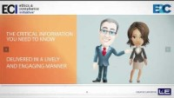

Slide 18


Slide 19
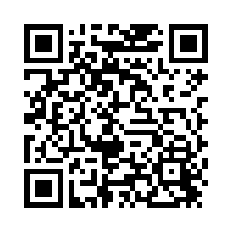
UCCS / DFEI Resources
Interested in accessing materials as a UCCS employee?

